Slide 1
Health Vision AI
Powered by CV models & LLM

Slide 2
Idea
AI-Driven Diagnostic Aid: Uses machine learning to classify diseases, supporting early detection and preliminary diagnosis for conditions like pneumonia, cancer, and gastrointestinal diseases.
Patient Engagement & Education: An interactive Language Model (LLM) provides users with accessible explanations and answers to health questions, promoting better understanding of diagnoses and treatments.
Centralized Medical Resource: Combines diagnostic tools with links of research papers and case studies, offering up-to-date information in one place for both patients and healthcare professionals.
Streamlined Healthcare Access: An accessible, resourceful platform designed to reduce consultation times, improve accuracy, and enhance healthcare accessibility, especially in resource-limited settings.

Slide 3
Usage
Disease Classification Models: Upload images (X-rays, CT-scans, endoscopic images) to classify conditions such as Pneumonia, Lung Cancer, and Gastrointestinal Diseases.
Interactive Health Assistant: Engage with the LLM to ask questions about specific diseases, symptoms, and treatment options, providing tailored responses for better understanding.
Research & Case Report Access: View linked resources for further reading on current research and case studies, aiding in in-depth knowledge and reference.
User-Friendly Interface: Intuitive layout with a prompt bar, clickable research links, and light-themed, professional design, making it easy for users of all backgrounds to navigate.

Slide 4
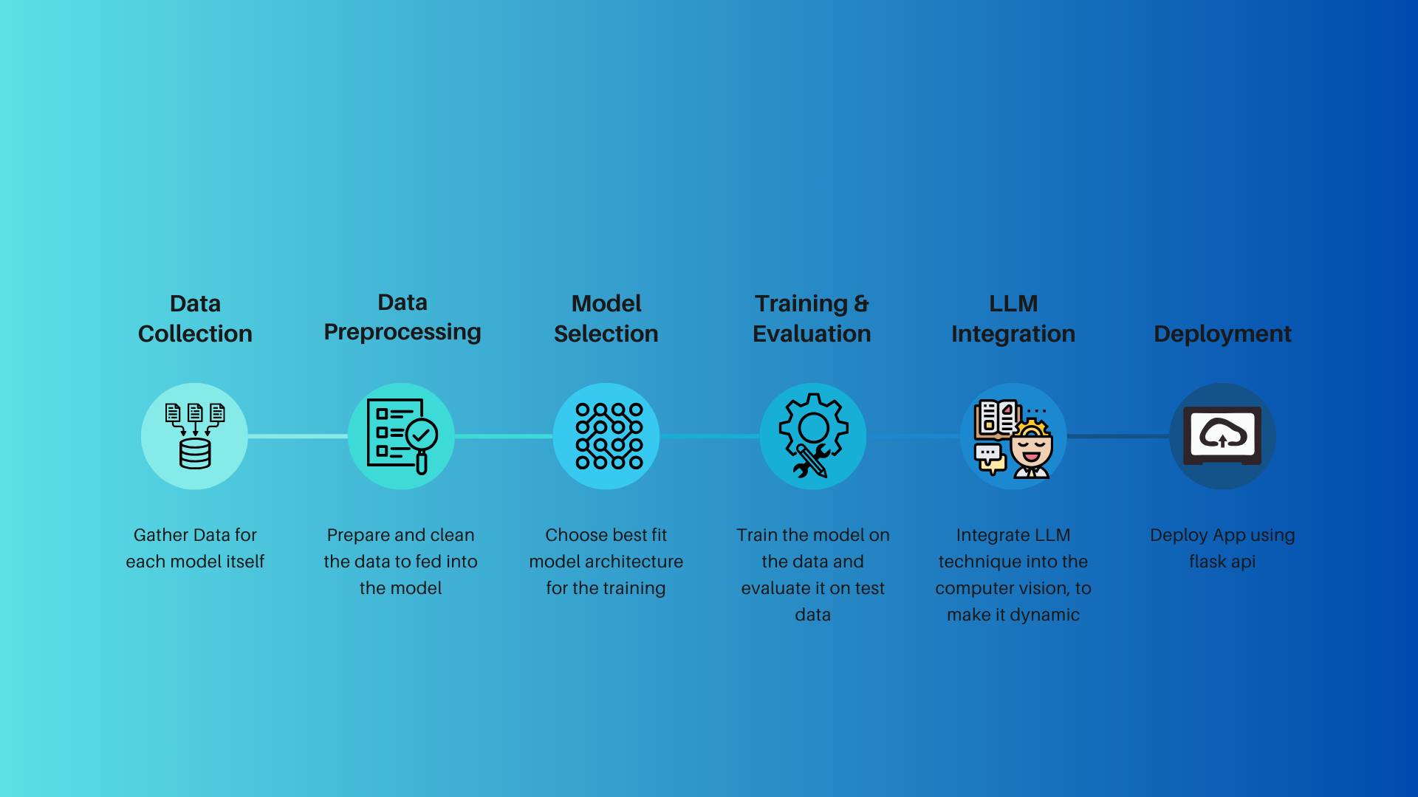
Implementation Plan

Slide 5
Architectures Used
Vision Transformers (ViT)
Purpose: Ideal for handling complex image data by splitting images into patches, which are processed as tokens, similar to words in NLP.
Usage: Applied for medical image classification, like Chest X-rays, due to its accuracy and capability in image segmentation and availability of large data.
Swin Transformer
Purpose: A hierarchical transformer structure that captures both local and global image features, crucial for high-resolution medical images.
Usage: Effective for endoscopic images when having less amount of data, enhancing feature extraction for better disease classification.
GPT
Purpose: Known for natural language processing, GPT-2 is trained to generate human-like text and answer questions.
Usage: Integrated to respond to user queries on medical conditions, treatments, and classifications, enhancing interactivity and utility in healthcare contexts.

Slide 6
Metrics
Architecture | Gastrointestinal Model (Accuracy) | Chest CT Scan Model (Accuracy) | Chest X-Ray Model (Accuracy)
ViT | 93% | 75% | 88%
Swin | 98% | 90% | 86%

Slide 7
Hassaan Idrees
Thank You
AI Engineer - eager to apply expertise in real-world AI projects

